Slide 1
Image Processing with MATLAB®
Dr. Amr Amin
Ahmed Alqassas
* Check this link for summarized video on YouTube https://youtube.com/playlist?list=PLOFv_lij0VG9sELH0q6_QnRbGR7eHstvI&si=RrZgSICckMm4s4S_

Slide 2
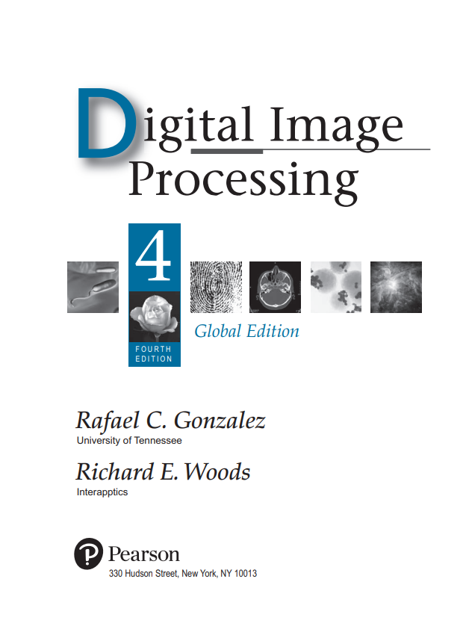

https://www.mathworks.com/help/pdf_doc/images/images_ug.pdf

Slide 3
Digital Images
A digital image is composed of a finite number of elements, each of which has a particular location and value.

Slide 4
Digital Images
A digital image is composed of a finite number of elements, each of which has a particular location and value.

Slide 5
Digital Images
A digital image is composed of a finite number of elements, each of which has a particular location and value.

Slide 6
Digital Images
A digital image is composed of a finite number of elements, each of which has a particular location and value, called Pixels.

Slide 7
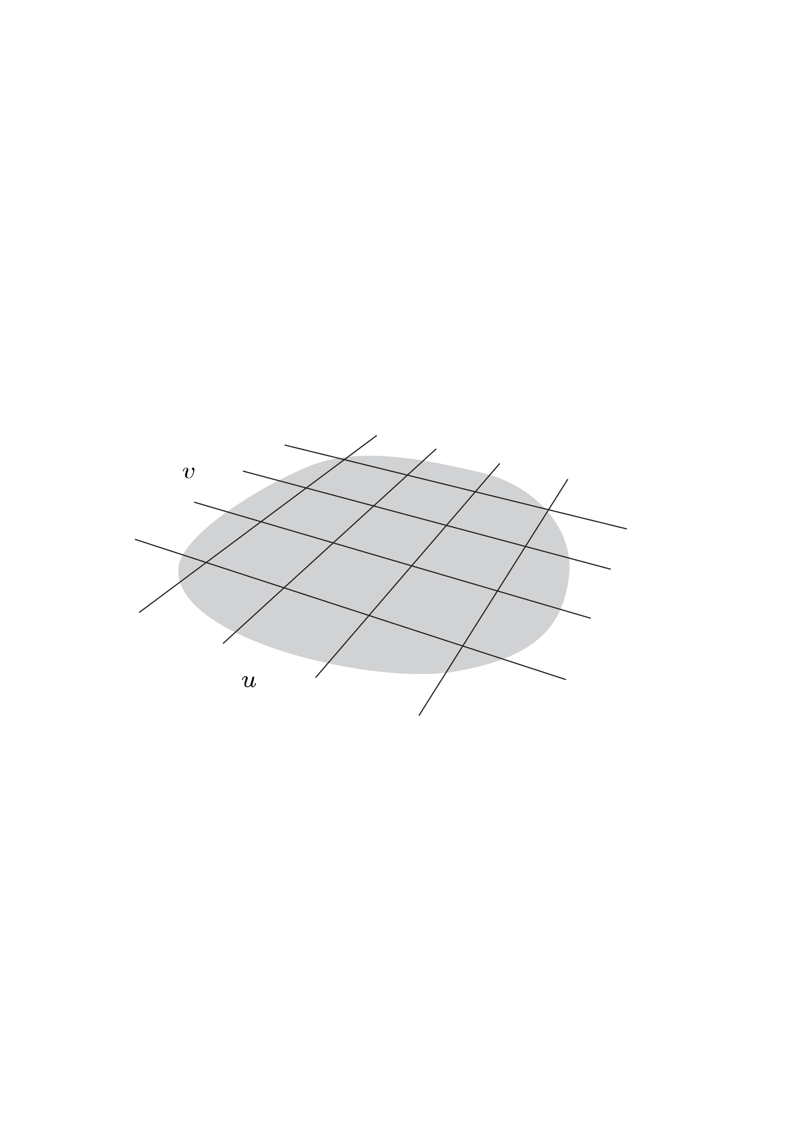

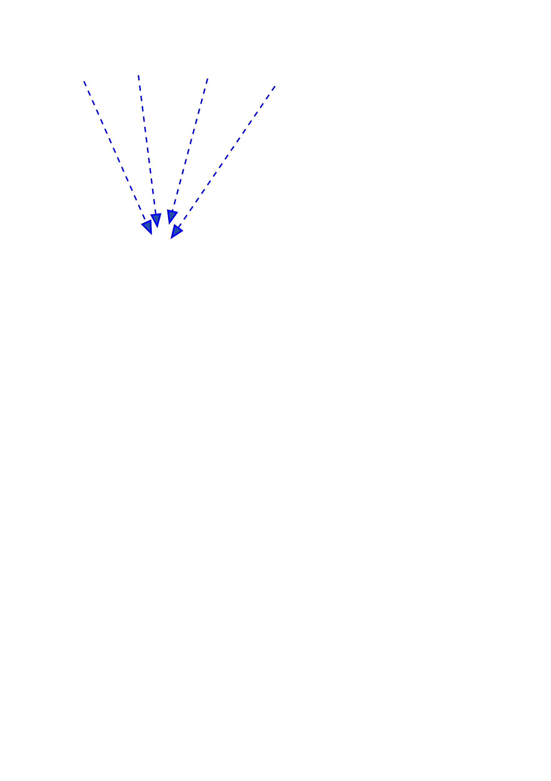

Incident light
Sensor array
Image element I(u, v)

Slide 8
Incident light
Acquisition
Sampling
Quantization
Sampling captures continues signal at discrete-time points.
Quantization is reducing the number of distinct colors or intensities in an image.
Sensor array
Image element I(u, v)

Slide 9
Images in MATLAB®

Slide 10
Images in MATLAB®
MATLAB stores most images as matrices, in which each element of the matrix corresponds to a single pixel in the displayed image.

Slide 11
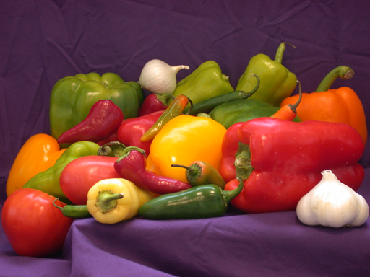
peppers.png

Slide 12
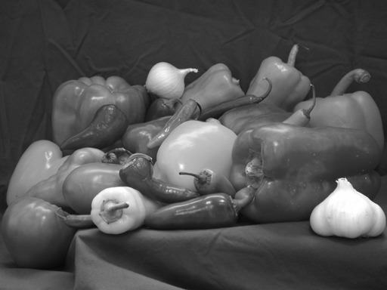
>> rgb_img = imread('peppers.png');
>> gray_img = rgb2gray(gray_img);
>> imshow(gray_img);
>> size(gray_img)
ans =
384 512

Slide 13
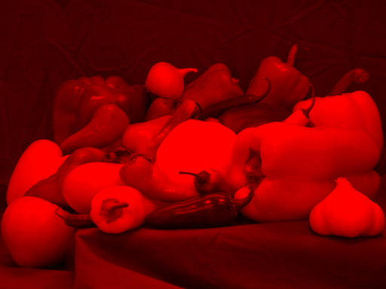
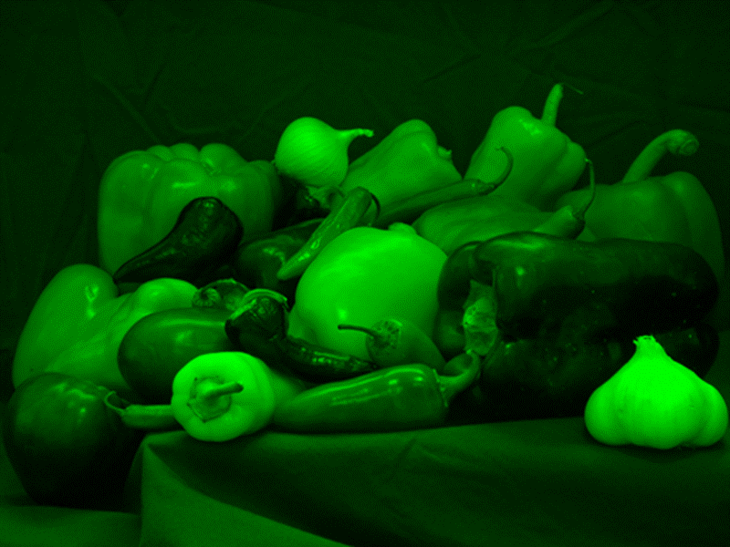
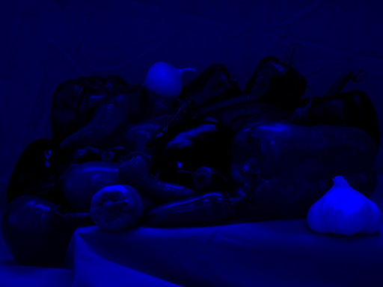
>> rgb_img = imread('peppers.png');
>> imshow(rgb_img)
>> size(rgb_img)
ans =
384 512 3
* Check lab 1 manual in video description to learn how to split an image into its channels

Slide 14
>> rgb_img = imread('peppers.png');
>> imshow(rgb_img)
>> size(rgb_img)
ans =
384 512 3
>> whos('rgb_img')
Name Size Bytes Class
rgb_img 384x512x3 589824 uint8

Slide 15
>> whos('rgb_img')
Name Size Bytes Class
rgb_img 384x512x3 589824 uint8
Bytes tells you that the image occupies 589,824 bytes (0.59 MB) in the MATLAB workspace. Not the file size on device storage.
Bit-depth
Class tells you how many Bytes per element are used. uint8 means that 8 bits are used to represent each element.

Slide 16
Example 1
Determine the number of bytes necessary to store an uncompressed RGB color image of size 384 × 512 pixels using 8, 12,16, and 64 bits per color channel.
bit-depth | Rows | Columns | Channels | Bytes/element | Size (in bytes)
8-bits | 384 | 512 | 3 | 8/8 = 1 bytes | 589,824
12-bits | 384 | 512 | 3 | 12/8 = 1.5 bytes | 884,736
16-bits | 384 | 512 | 3 | 16/8 = 2 bytes | 1,179,648
64-bits | 384 | 512 | 3 | 64/8 = 8 bytes | 4,718,592

Slide 17
Types of Images
Binary
Grayscale
Indexed
Truecolor (or RGB)
Label
and more..

Slide 18
Thank You

